Slide 1



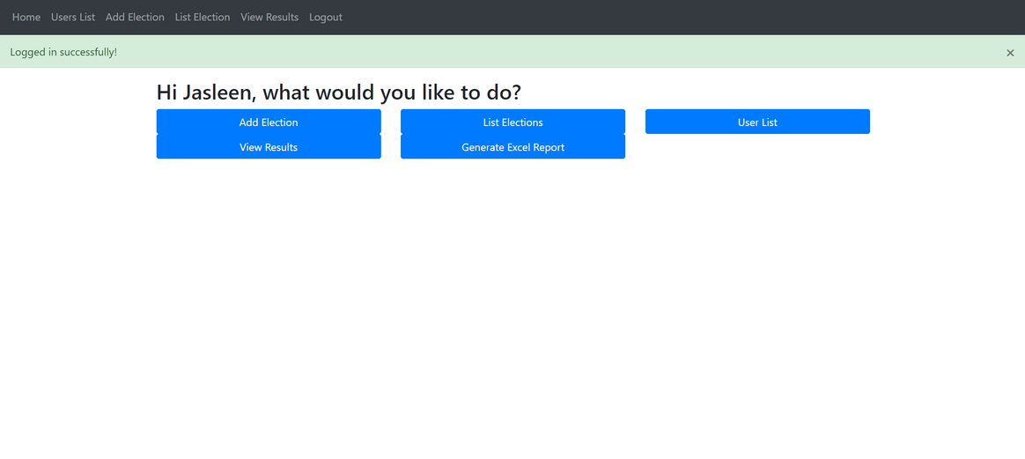

Home
About us
Vote Now
Contact
EVoting App
Object-Oriented Programming Module
Next

Slide 2



Users
Admins are responsible for managing the election process. They use the system to create elections, manage voter registration, monitor voting activities and generate reports.
ADMIN
They participate in the election process by casting their votes. They use the system to access elections, select candidates, and submit their votes either in-person at voting booths or remotely through the online platform.
VOTER
Candidates are individuals running an election. They may use the system to monitor their campaign progress, submit nominations and view election results.
CANDIDATE

Slide 3
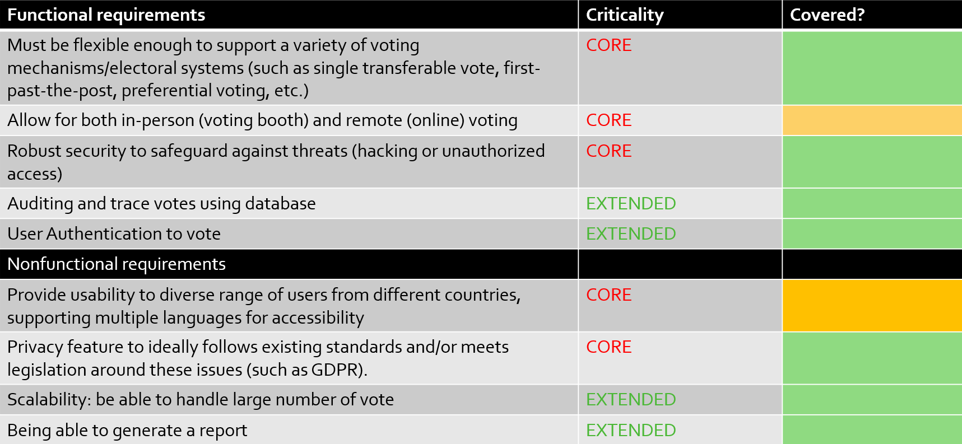
User Requirements

Slide 4
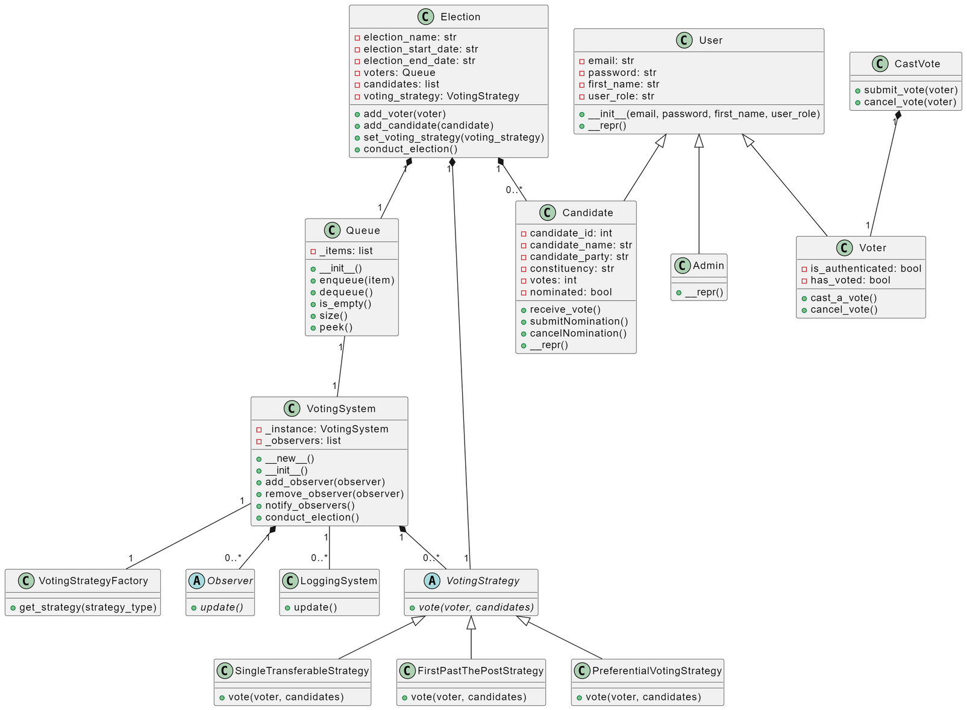
UML Diagram
*PDF version of the diagram attached

Slide 5
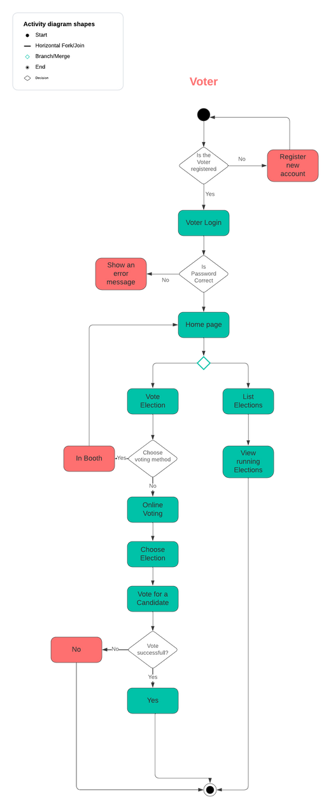
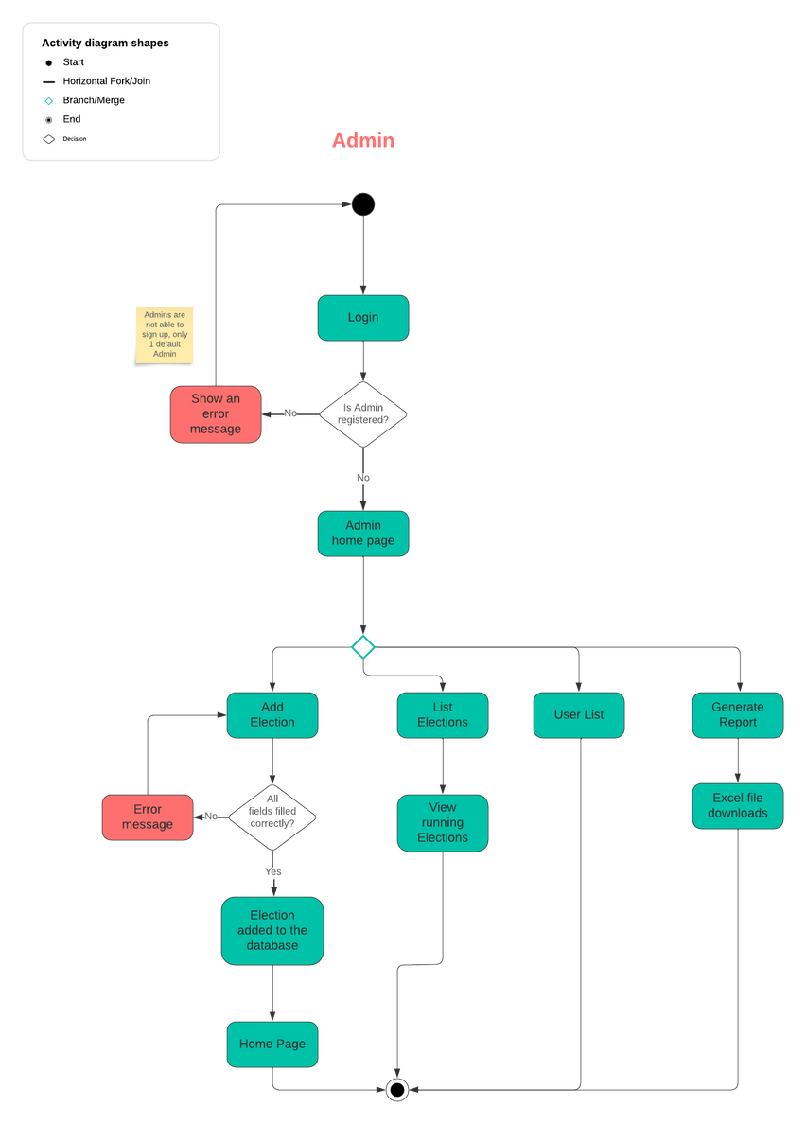
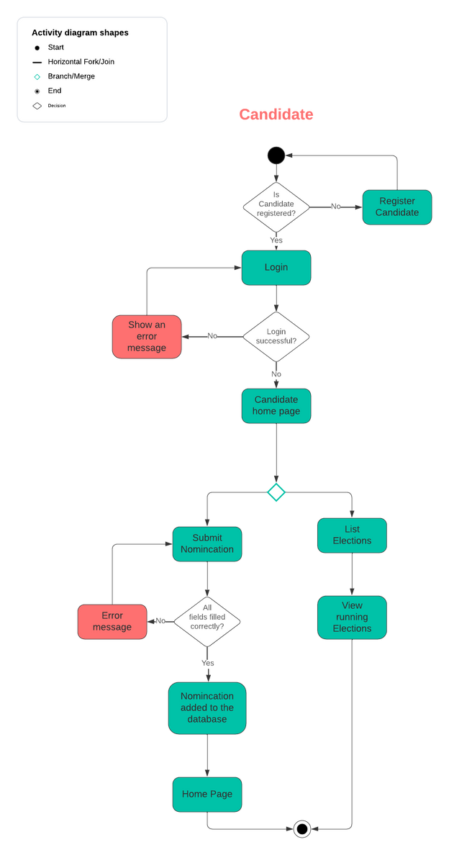
Activity Diagram
Candidate
Voter
Admin
*PDF version of the diagram attached

Slide 6
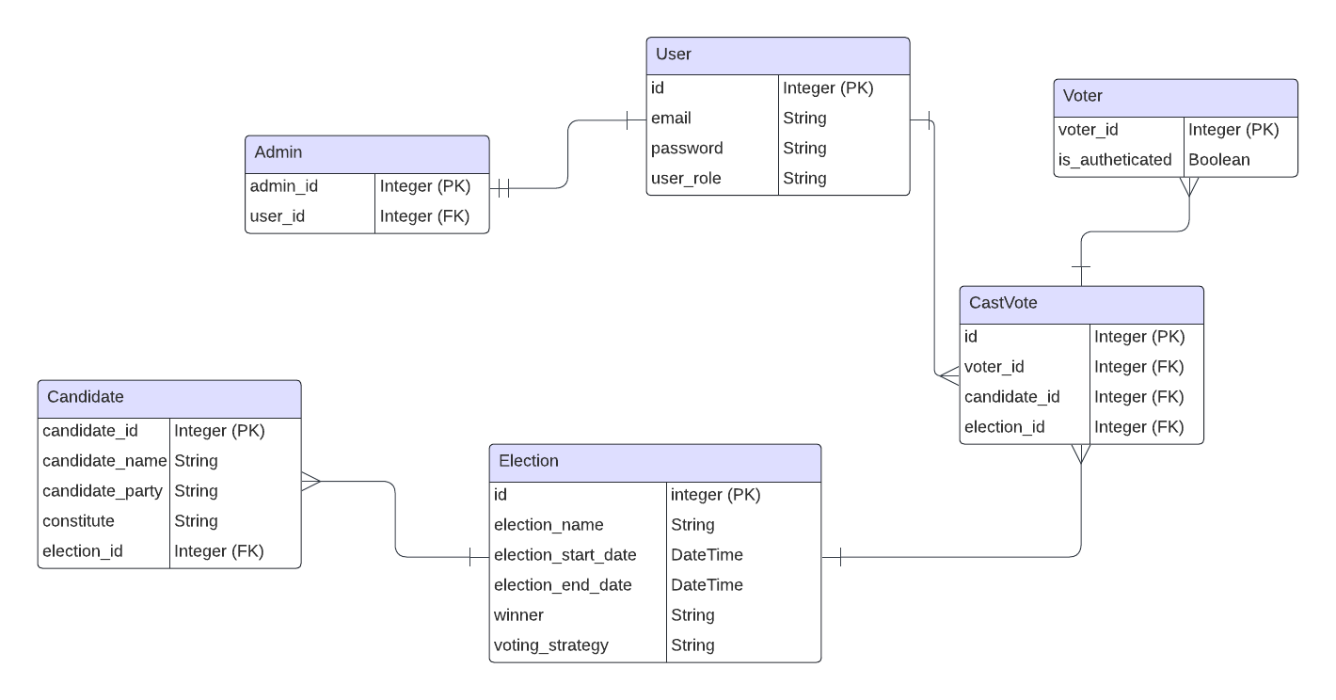
ERD
*PDF version of the diagram attached

Slide 7
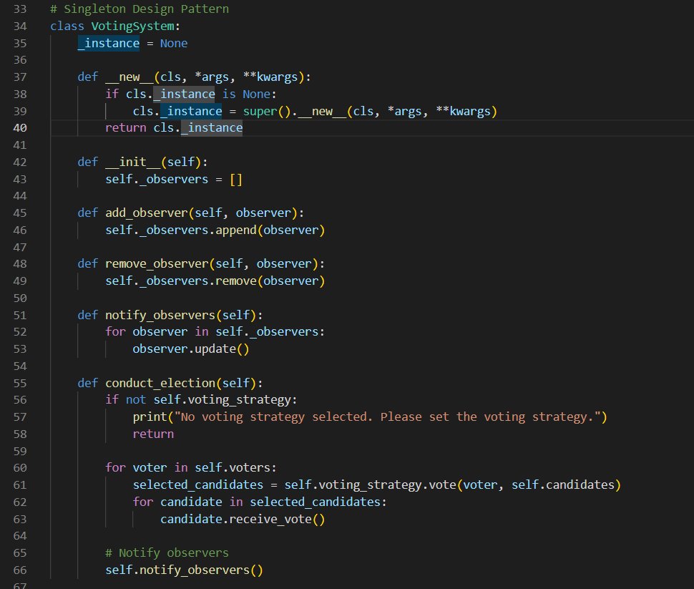
Evaluation of Design pattern
Singleton
Used Singleton design pattern as part of the VotingSystem to ensure that only one voting system can exist
Benefits: Makes it easier to control as it’s centralised and removes any unnecessary duplication
Limitations: Tight coupling of the code, making it harder to modify in later stages

Slide 8
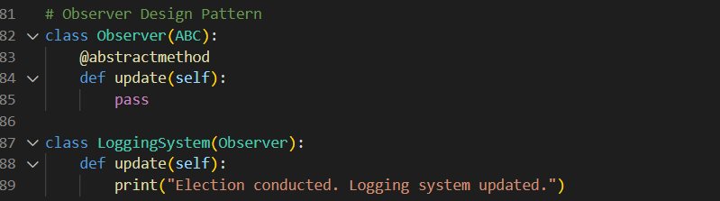
Evaluation of Design pattern
Observer
Used Observer pattern which can be seen in the LoggingSystem class
Reason I have used this was to help decouple VotingSystem from LoggingSystem, allowing a more flexible design. Also promotes maintainability and scalability, meaning we add new functionalities in the future
Limitation: Adds extra complexity to the system if the number of observers scale

Slide 9
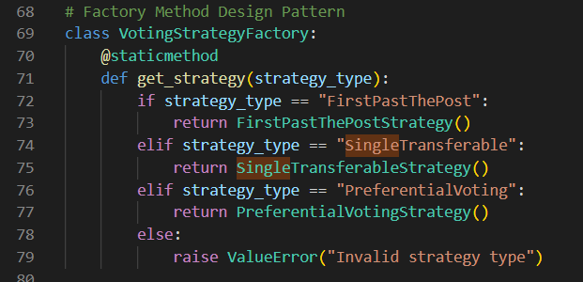
Evaluation of Design pattern
Factory Method
Factory method used within VotingStrategyFactory Class which takes in the strategy_type as parameter and returns the instance of the voting strategy based on the type, without knowing full details of how each strategy is implemented
Benefits: Allows to add any new voting strategies without modifying existing code
Limitations: Will require managing of the factory to keep up to date

Slide 10
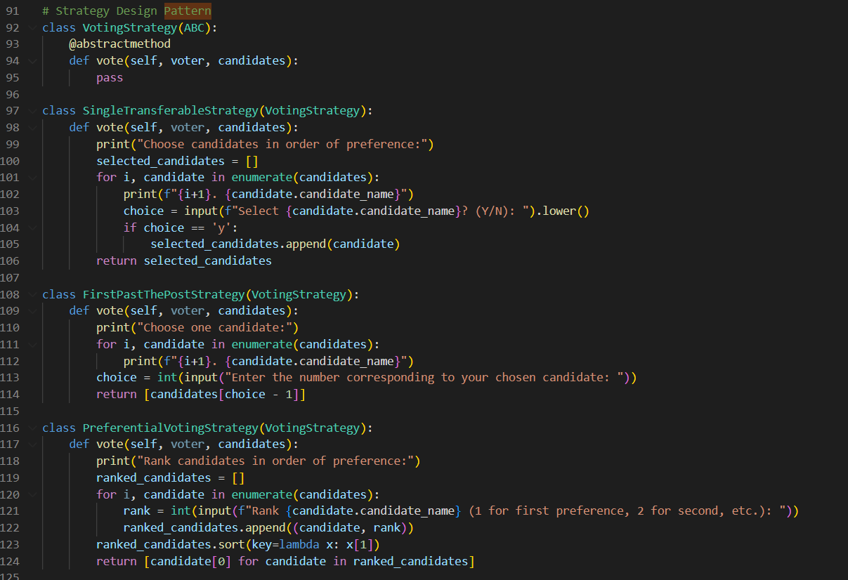
Evaluation of Design pattern
Strategy
Strategy pattern has been used to encapsulate the different voting strategies within my applications
Each voting strategy primarily inherits from VotingStrategy
Benefits: Code maintainability and modification easily
Limitations: Increase number of classes to manage
Overall, it allows dynamic use of classes for the scenario at hand

Slide 11
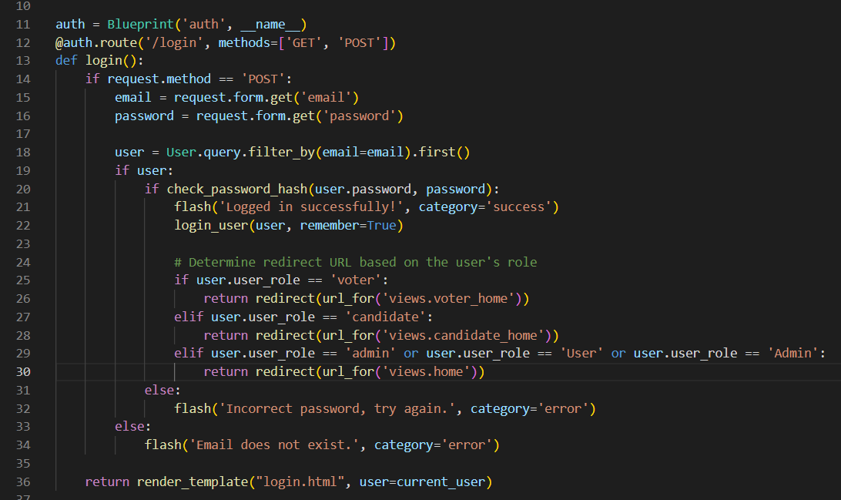
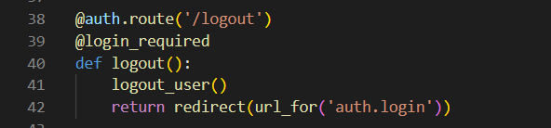
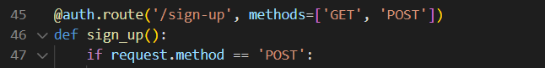
Evaluation of Design pattern
Decorator

Slide 12
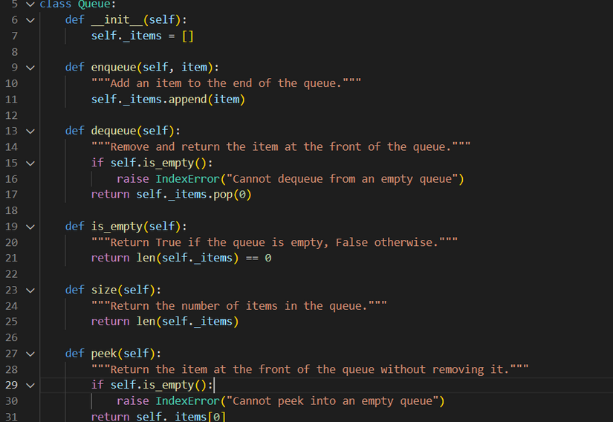
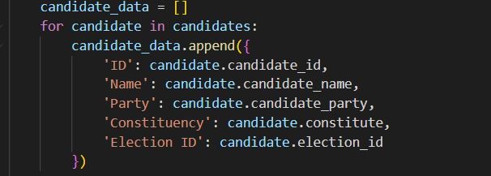
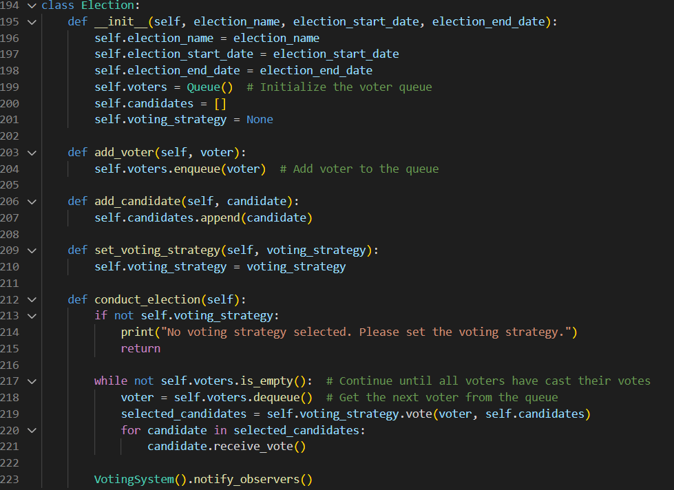
Data Structures
What I have used:
Queues
Dictionaries
Lists

Slide 13
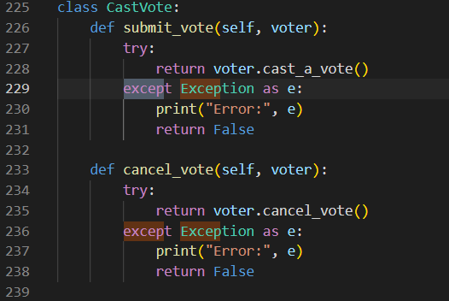
Exception handling

Slide 14
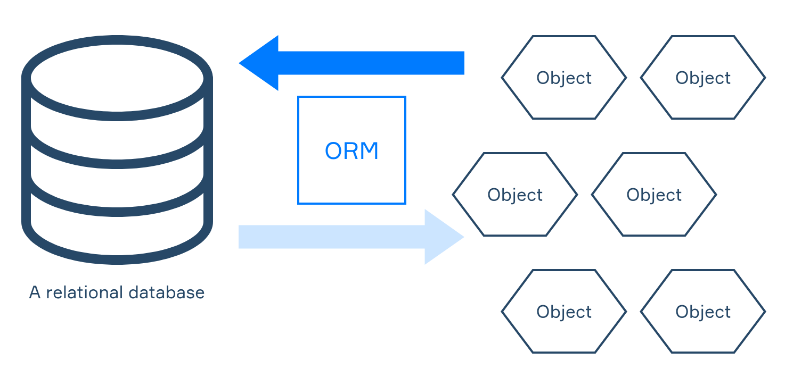

Persistent data

Slide 15
DEMO
Present

Slide 16
Evaluation of OO Features and Principles
DRY (Don’t repeat Yourself)
Benefits: It Avoids duplicating code through the reuse of classes, methods and attributes
For example, the ‘Voter’ and ‘Candidate’ classes share common attribuites
YAGNI (You Aren’t going to need it
This principles implements only needed features require for the application
The benefit of this was that I avoided adding any extra complexity which were no use to the user, producing a Minimum Viable Product
KISS (Keep it Stupid Simple)
Example of this in VotingSystem class which show cases simplicity by having a range of descriptive and easy to comprehend methods.
Comparison of features available in (other) programming languages
I have chosen python as my preferred language due to its OOP capabilities, compared to C# originally taught within the module such as python’s easy readibility and python’s large choice of libraries.
Python does not however provide clear access to modifiers (i.e public, private), relying more on naming convetions.
Solid Principles
Single Responsibility Principle: each class, i.e Election has clear responsiblility and perform one single function
Liskov Substituition Principle: I have utilised polymorphism and inheritance to ensure that child classes can be substituited without effecting additional functionality

Slide 17
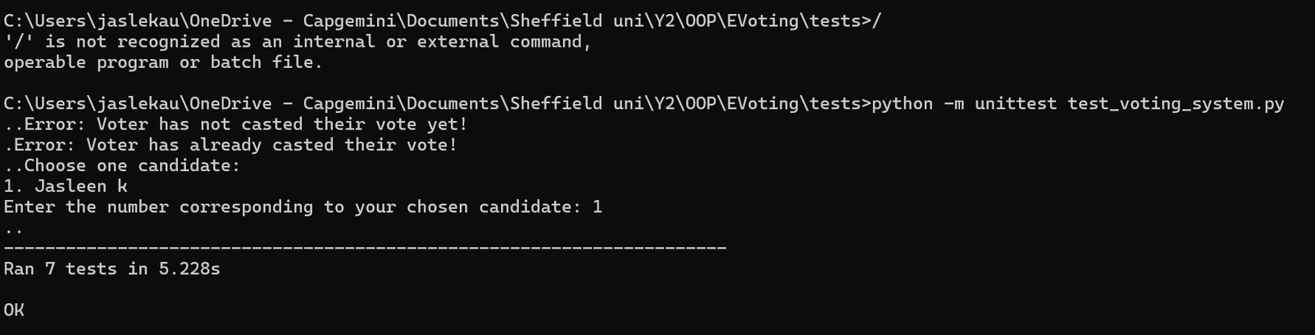
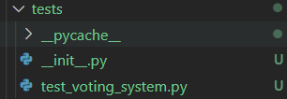
Unit Tests
How well does my program meet the set requirements?
Through the use of Test Driven Development TDD to perform testing, I have found that my programs functionality work well as I am able to add voters, add candidates and successfully vote. If the user has not casted their vote, an error is also raised. I am able to see all 7 test cases being ran (see below).
Testing methods applied?
AssertEqual()
AssertIsInstance()
AssertTrue()
AssertIs()

Slide 18



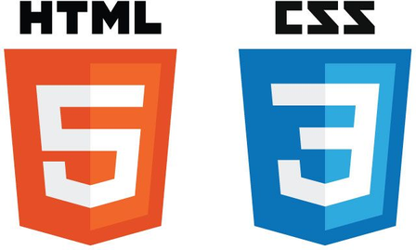
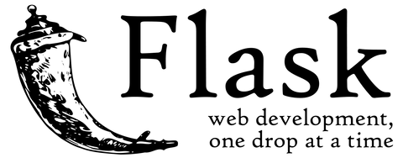
Pandas Development
Self Learning
SQL Alchemy (ORM)
Python (OOP)
HTML, CSS AND Jinja
Flask Framework

Slide 19
References
https://kinsta.com/blog/python-object-oriented-programming/
https://www.digitalocean.com/community/tutorials/how-to-use-flask-sqlalchemy-to-interact-with-databases-in-a-flask-application - this resource helped me setup my database using flask framework
https://flask.palletsprojects.com/en/3.0.x/
https://developer.mozilla.org/en-US/docs/Learn/Getting_started_with_the_web/HTML_basics
https://jinja.palletsprojects.com/en/3.1.x/templates/
https://sourcemaking.com/design_patterns
https://www.youtube.com/watch?v=mqhxxeeTbu0&list=PLzMcBGfZo4-n4vJJybUVV3Un_NFS5EOgX
https://www.w3schools.com/python/pandas/default.asp
https://pandas.pydata.org/pandas-docs/stable/reference/api/pandas.DataFrame.to_excel.html

